Slide 1

Qiskit Fall Fest 2025 Paris-Saclay
Hackaton
Quandela challenge 2 - QML for swaptions prediction
Matteo Piccolini
Sponsored by:
Notes:
Hi, im matteo piccolini and this is my project for the quandela challenge track number 2 presented at the qiskit fall fest 2025 hackaton

Slide 2
Goal and chosen framework
Given a dataset of swaptions prices, use Quantum Machine Learning techniques to predict future values over a period of two weeks
Chosen model: Quantum Reservoir Computing (QRC) with a single reservoir
Main reference:
  Li, Q., Mukhopadhyay, C., Bayat, A., & Habibnia, A. (2025). Quantum Reservoir Computing for Realized Volatility Forecasting. arXiv preprint arXiv:2505.13933
Other references:
  Li, Q., Mukhopadhyay, C., Minati, L., & Bayat, A. (2025). Quantum reservoir computing for predicting and characterizing chaotic maps. arXiv preprint arXiv:2509.12071
  Yasuda, T., Suzuki, Y., Kubota, T., Nakajima, K., Gao, Q., Zhang, W., Shimono, S., Nurdin, H. I., & Yamamoto, N. (2023). Quantum reservoir computing with repeated measurements on superconducting devices. arXiv preprint arXiv:2310.06706

Slide 3
Quantum Reservoir Computing
Exploits memory effects in the dynamics of a fixed quantum system (reservoir)
Crucial difference with standard neural network: reservoir parameters are not trained → learning occurs only during classical post-processing of measurement results
Motivations to use:
  temporal dynamics → great prediction capacity for time series
  no computational burden of training neural networks
  implementations already conceptualized for different physical platforms

Slide 4
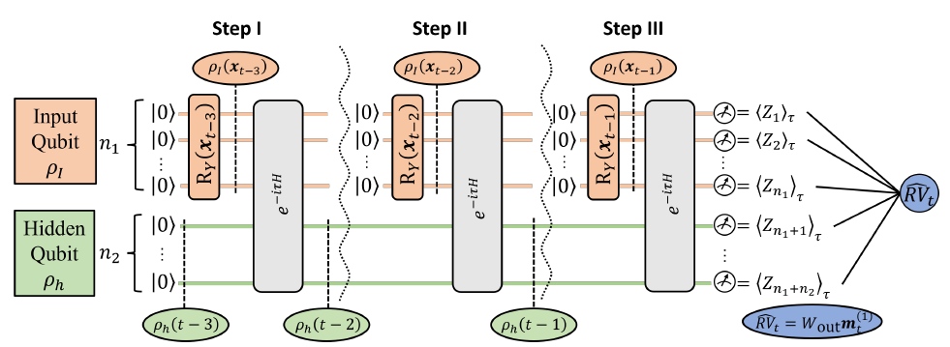
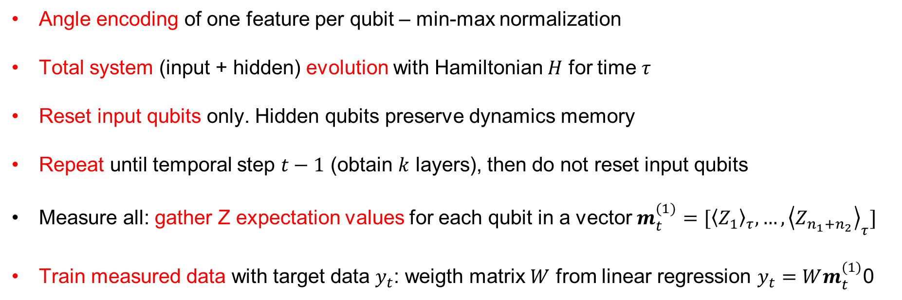
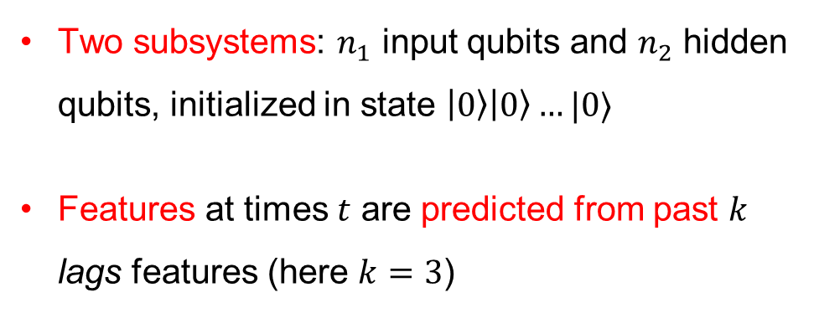
Quantum Reservoir Computing
Two subsystems: $n_{1}$ input qubits and $n_{2}$ hidden qubits, initialized in state $\left|0\right\rangle \left|0\right\rangle …|0⟩$
Features at times $t$ are predicted from past $k$ lags features (here $k=3$)
Angle encoding of one feature per qubit – min-max normalization
Total system (input + hidden) evolution with Hamiltonian $H$ for time $τ$
Reset input qubits only. Hidden qubits preserve dynamics memory
Repeat until temporal step $t−1$ (obtain $k$ layers), then do not reset input qubits
Measure all: gather Z expectation values for each qubit in a vector $m_{t}^{(1)}=[{\left\langle Z_{1}\right\rangle }_{τ}, …,{\left\langle Z_{n_{1}+n_{2}}\right\rangle }_{τ}]$
Train measured data with target data $y_{t}$: weigth matrix $W$ from linear regression $y_{t}=Wm_{t}^{(1)}$0

Slide 5
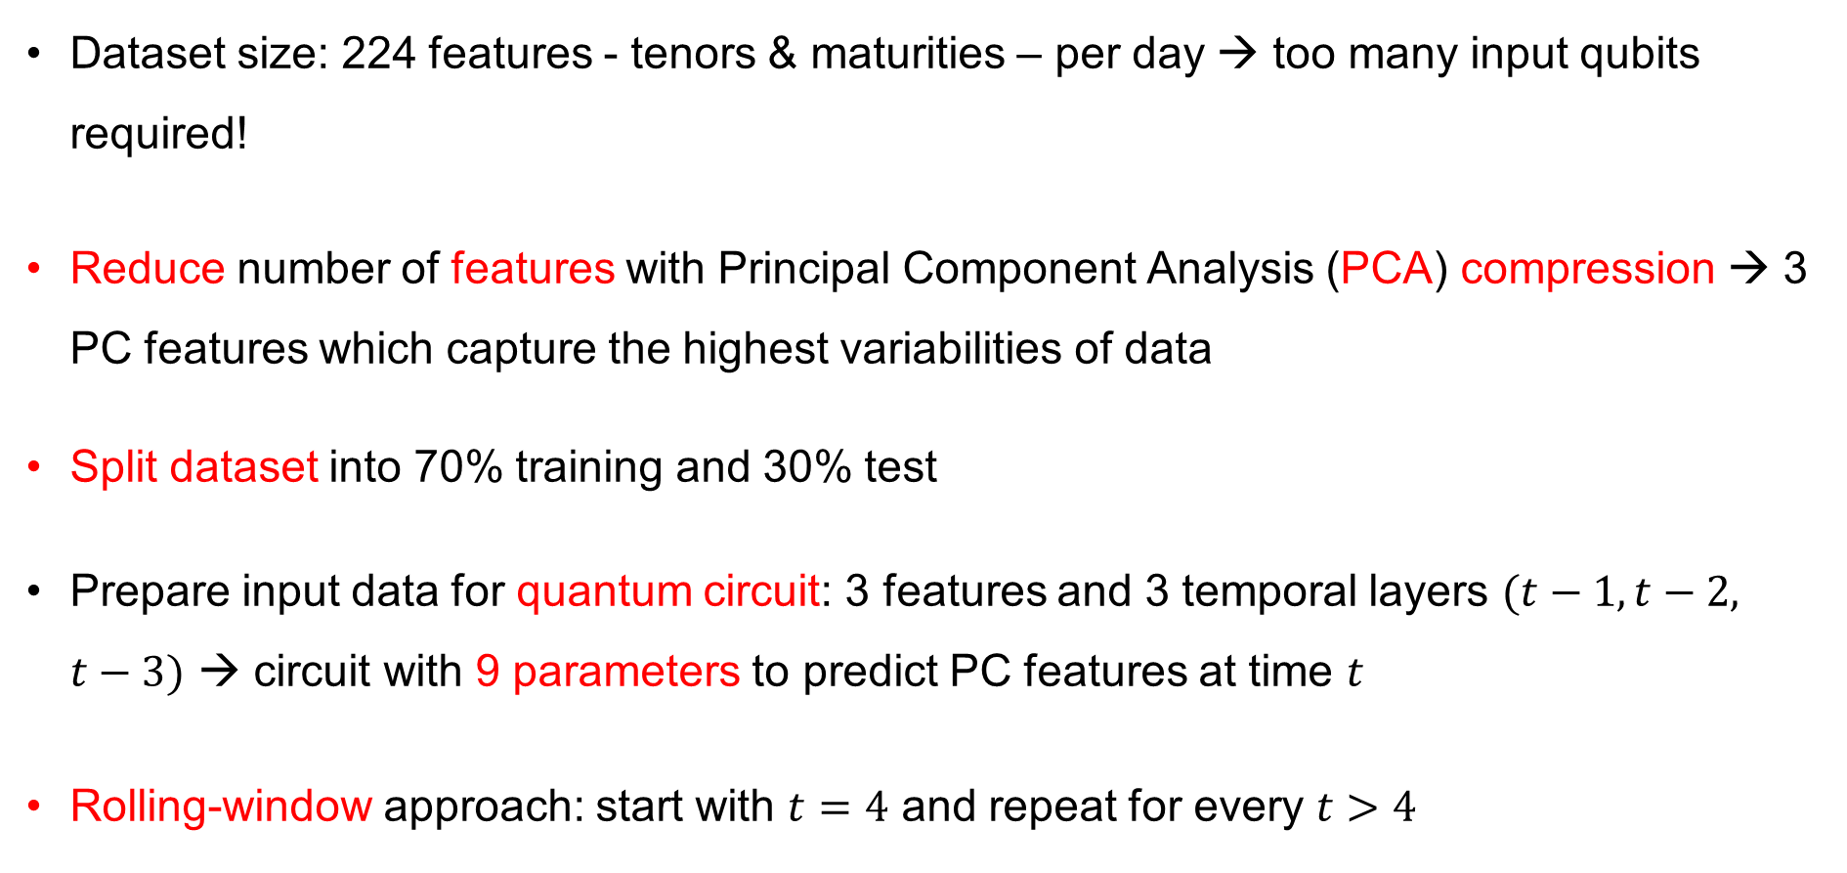
Step 1: data management
Dataset size: 224 features - tenors & maturities – per day → too many input qubits required!
Reduce number of features with Principal Component Analysis (PCA) compression → 3 PC features which capture the highest variabilities of data
Split dataset into 70% training and 30% test
Prepare input data for quantum circuit: 3 features and 3 temporal layers $(t−1, t−2, t−3)$ → circuit with 9 parameters to predict PC features at time $t$
Rolling-window approach: start with $t=4$ and repeat for every $t>4$

Slide 6
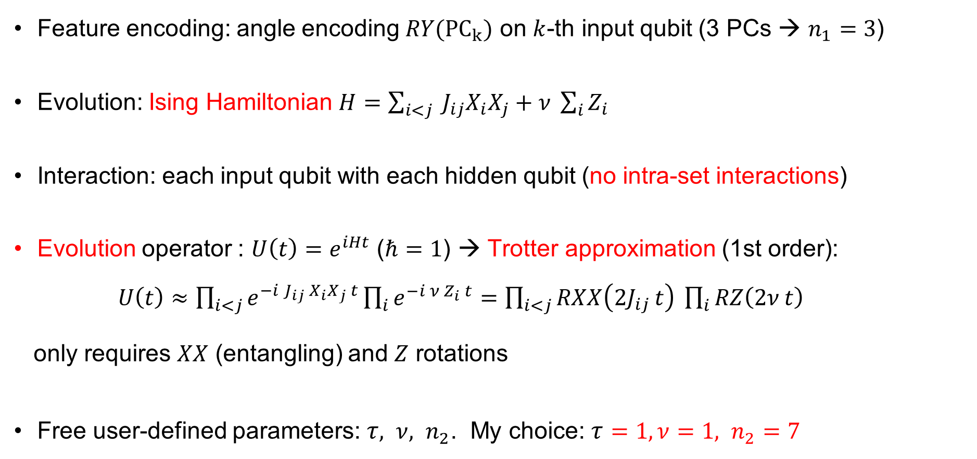
Step 2: create quantum circuit
Feature encoding: angle encoding $RY({PC}_{k})$ on $k$-th input qubit (3 PCs → $n_{1}=3$)
Evolution: Ising Hamiltonian $H=\sum_{i<j}{ J_{ij}X_{i}X_{j}}+ν \sum_{i}{Z_{i}}$
Interaction: each input qubit with each hidden qubit (no intra-set interactions)
Evolution operator : $U\left(t\right)=e^{iHt}$ ($ℏ=1$) → Trotter approximation (1st order): $U\left(t\right)≈\prod_{i<j}{e^{−i J_{ij} X_{i}X_{j} t}}\prod_{i}{e^{−i ν Z_{i} t}}=\prod_{i<j}{RXX\left(2J_{ij} t\right)} \prod_{i}{RZ\left(2ν t\right)}$
only requires $XX$ (entangling) and $Z$ rotations
Free user-defined parameters: $τ, ν, n_{2}$. My choice: $τ=1, ν=1, n_{2}=7$

Slide 7
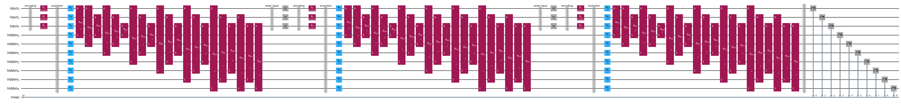
Step 3: run quantum circuit
Backend: real or simulator (user-defined for flexibility). My choice: simulator, due to runtime limitations on real IBM hardware
Circuit depth: 36 without noise model, 222 with simulated noise
Simulated noise: from IBMBackend('ibm_torino')
Qiskit Runtime Primitive: Sampler (shots = 10.000) → reconstruct expectation values from measurement results

Slide 8
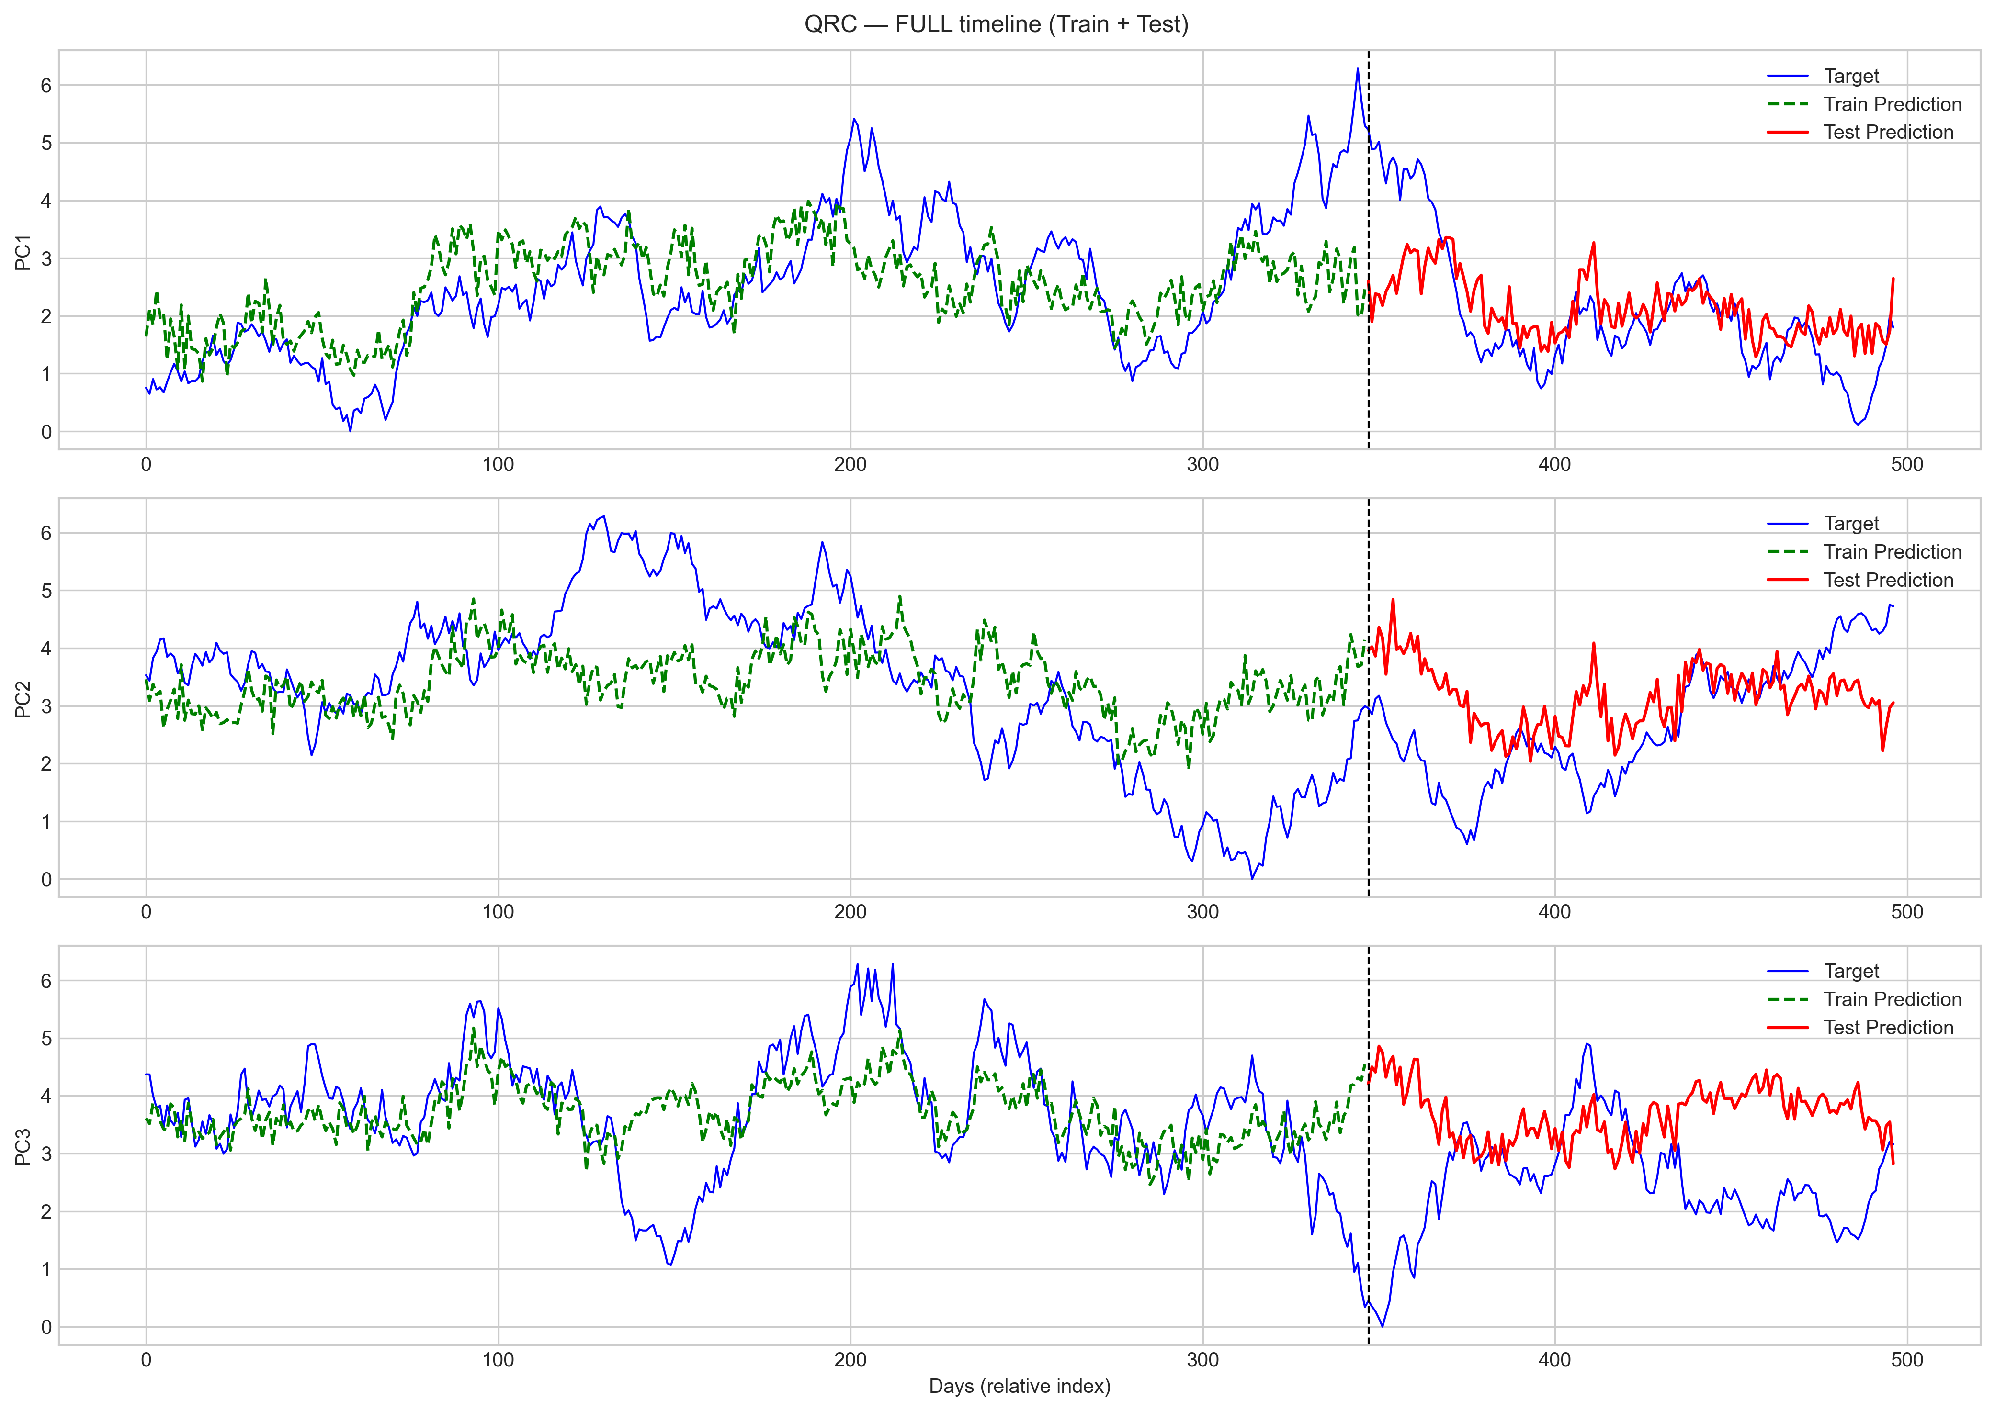
Step 4: post-process results (train & test)
Train the model with the measured expectation values
linear regression method: Ridge from sklearn
test results on the test part of the dataset

Slide 9
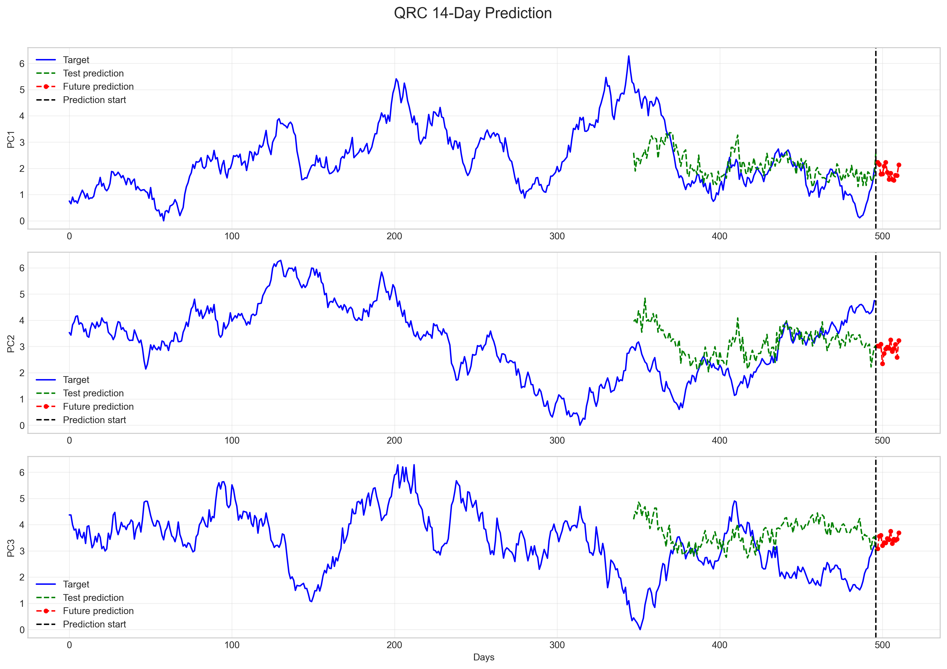
Step 5: generate future predictions over 2 weeks
Forecast next 14 days with the trained weight matrix
Revert PCs min-max normalization and decompress PCs → save dataset

Slide 10

Step 6: evaluate precision and compare
Precision evaluated by the Mean Squared Error (MSE) of the three PCs on test set
Precision compared with classical Gradient Boosting method
Results for the chosen parameters:

Slide 11
Links and Contacts
GitHub repository of the project:
https://github.com/matteo-piccolini/QRC_hackaton_Paris_2025/tree/main
LinkedIn profile:
https://www.linkedin.com/notifications/?filter=all
Email:
matteo.piccolini@gmail.com

